Slide 1
Building an Arduino robot with Bluetooth
Difficulty: Beginner – novice
Tutorial By Ryan Saunderson

Slide 2

Parts List:
1x Arduino Uno
1x Bluetooth Slave
1x Bread board
1x L923D H-Bridge IC
1x 10uF Capacitor
2x DC 12V Motors
3 Different colors of wire

Slide 3
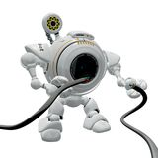
Assembly
Time to bread board!
Make sure all your parts are ready
Lets begin!

Slide 4
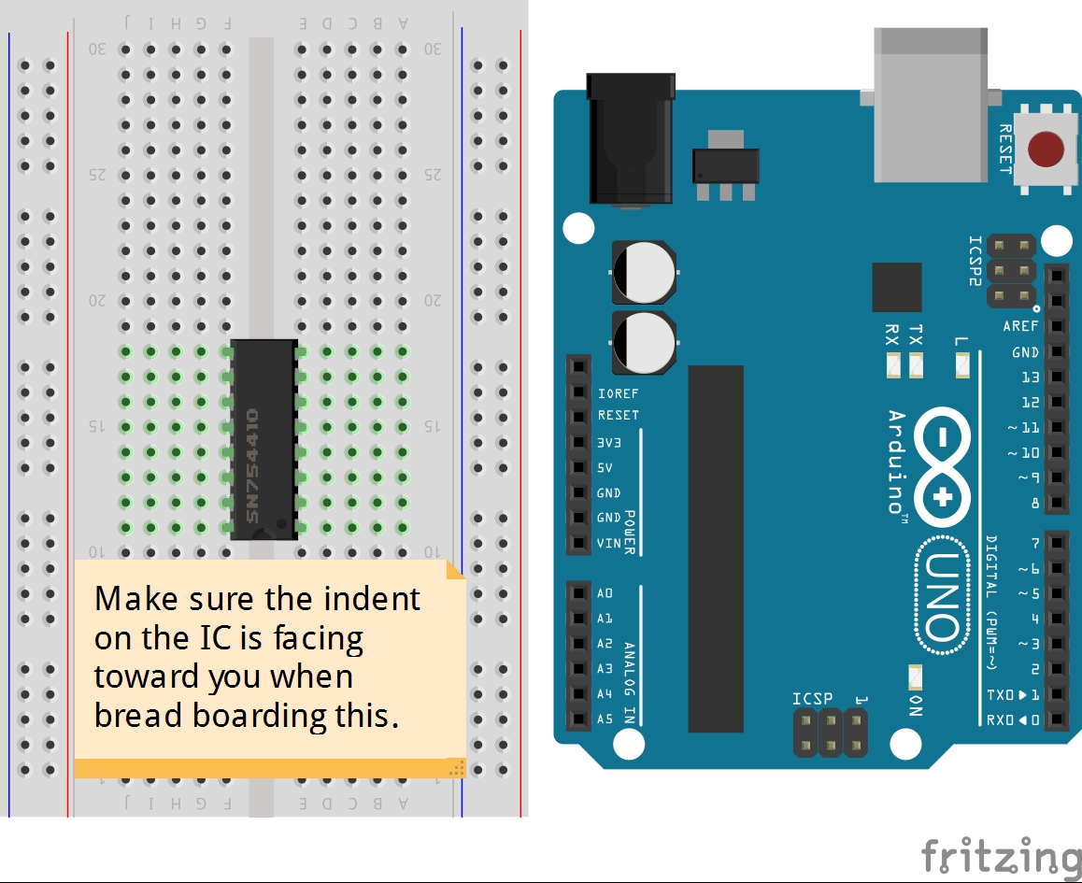
Step One

Slide 5
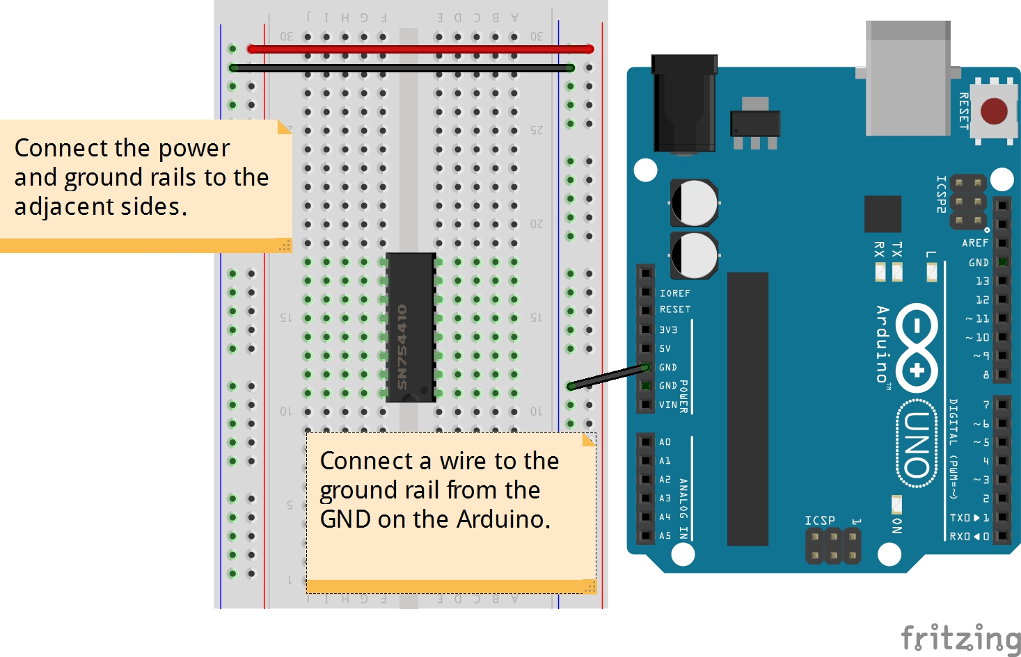
Step Two

Slide 6
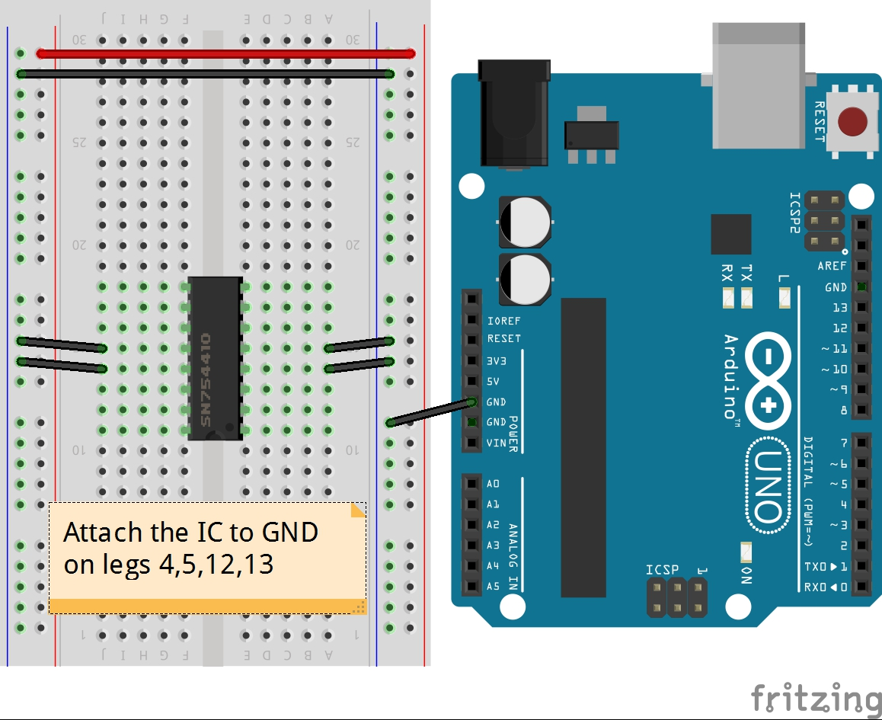
Step Three

Slide 7
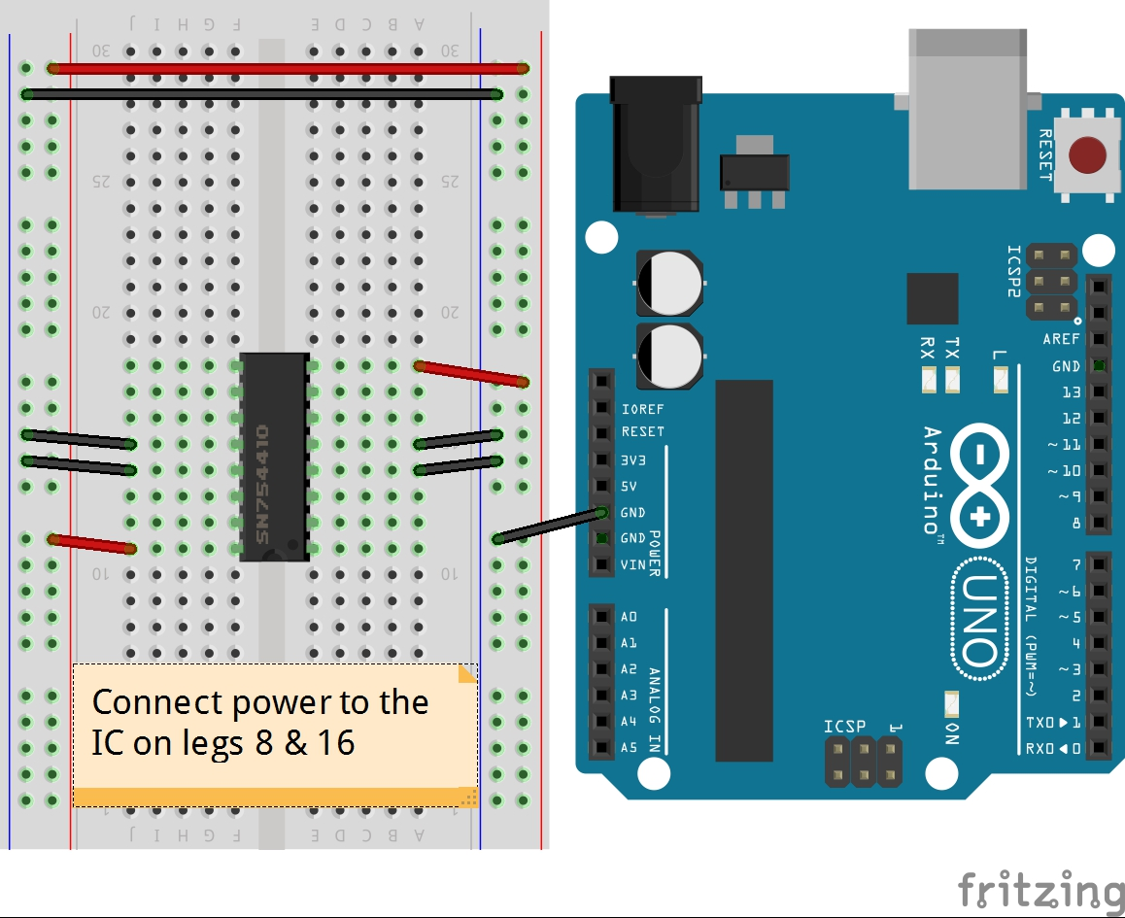
Step Four

Slide 8
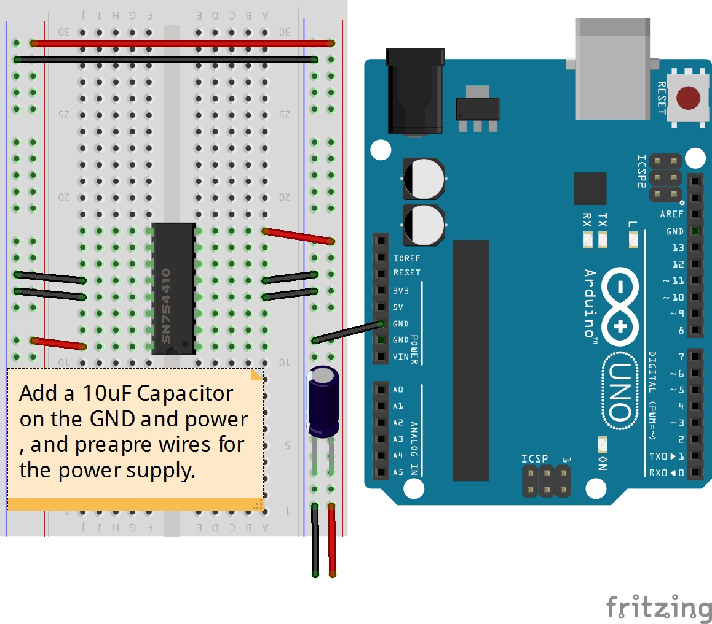
Step Five

Slide 9
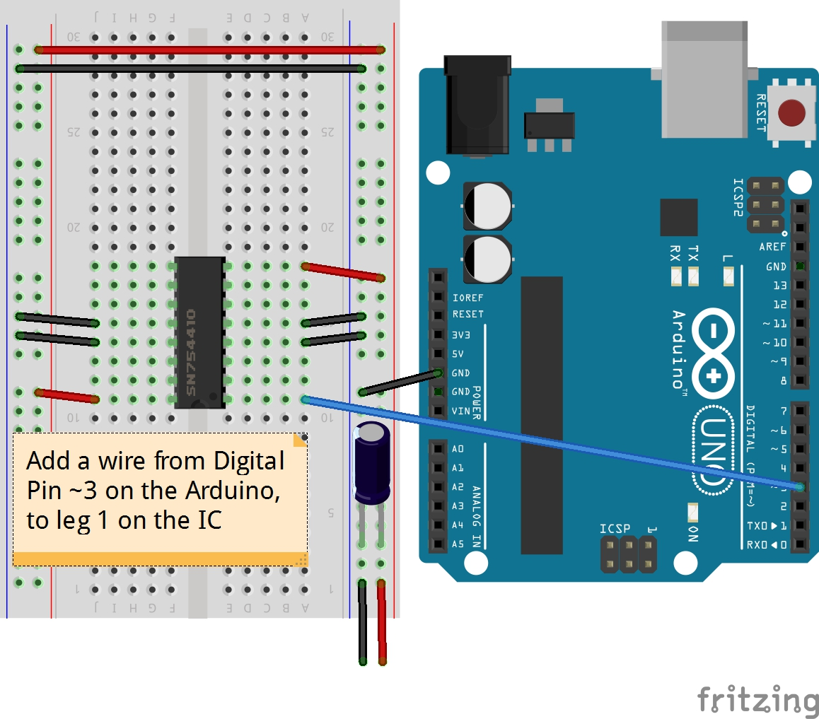
Step Six

Slide 10
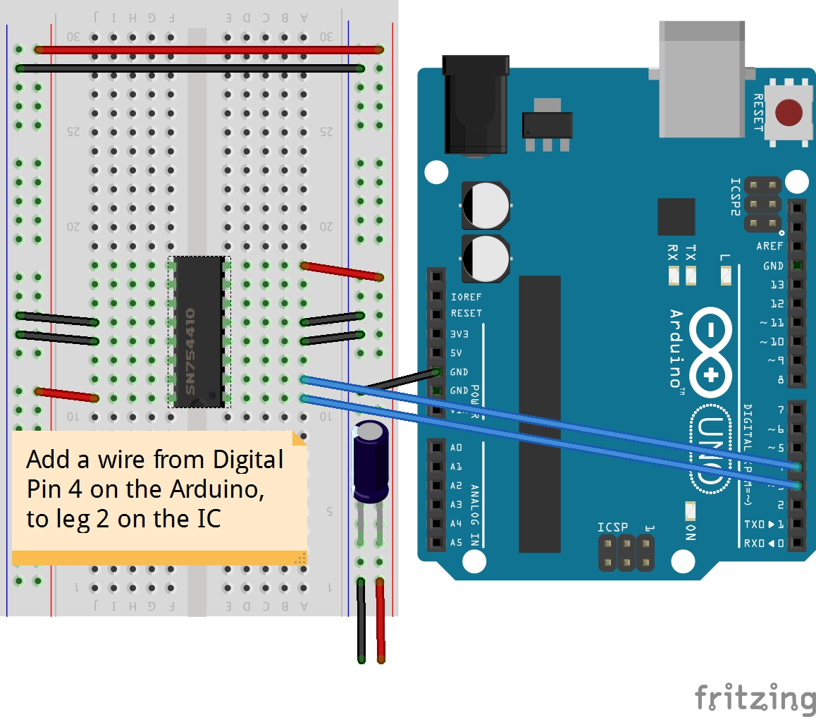
Step Seven

Slide 11
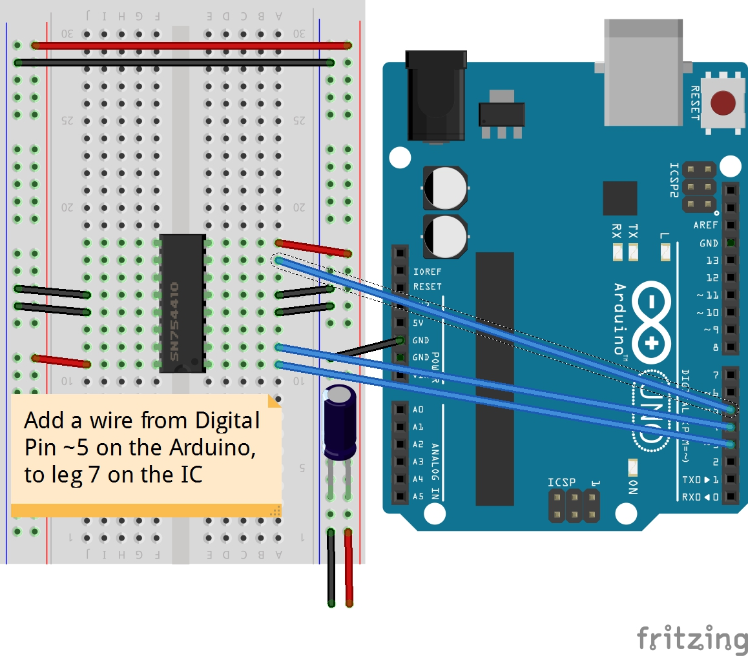
Step Eight

Slide 12
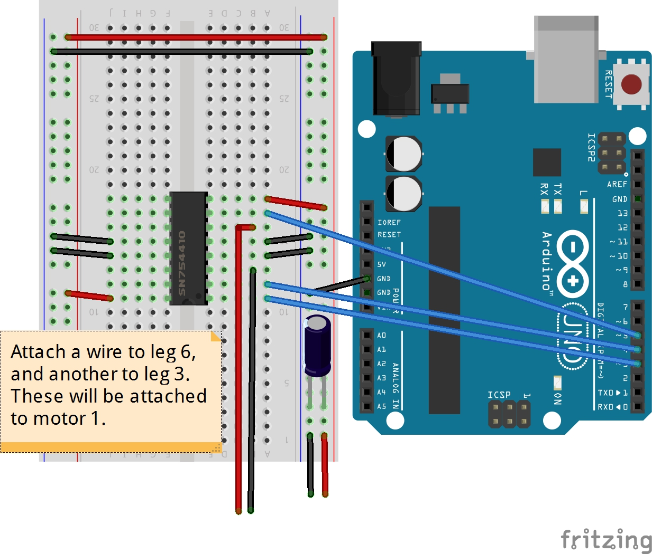
Step Nine

Slide 13
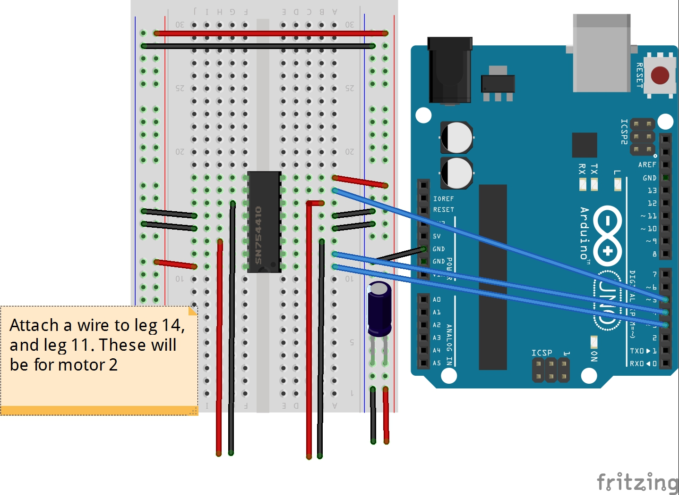
Step Ten

Slide 14
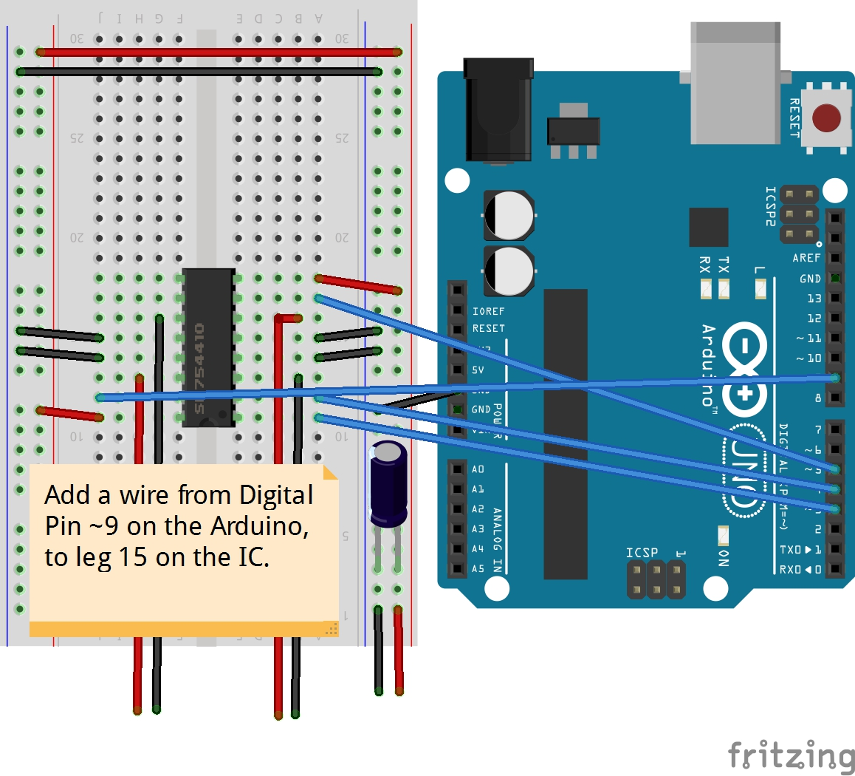
Step Eleven

Slide 15

Step Twelve

Slide 16
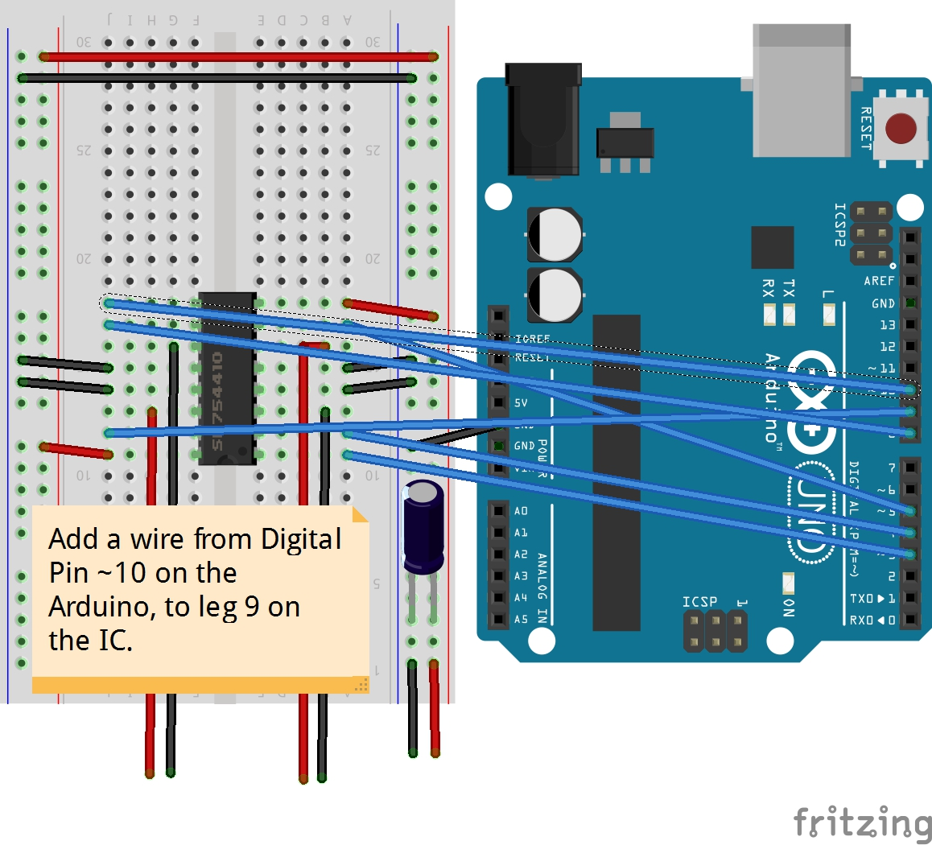
Step Thirteen

Slide 17
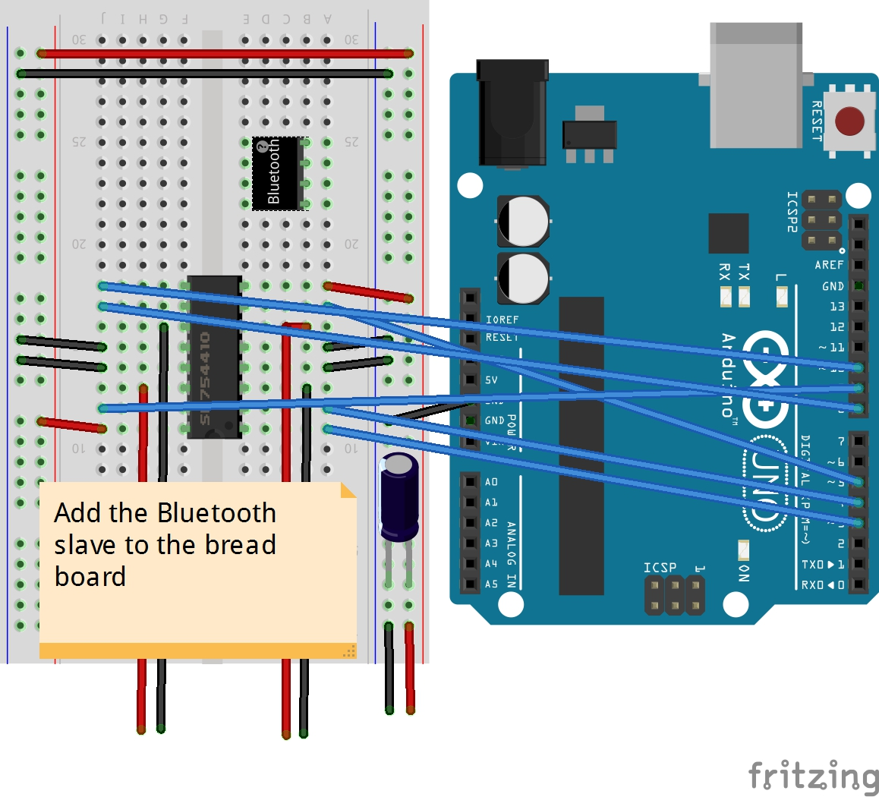
Step Forteen

Slide 18
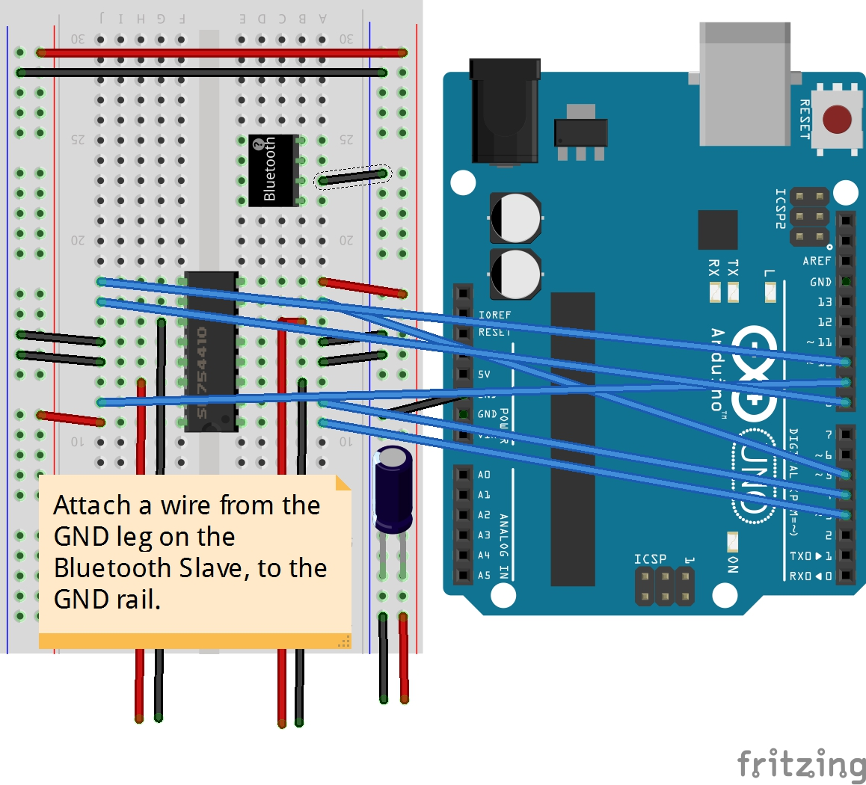
Step Fifteen

Slide 19
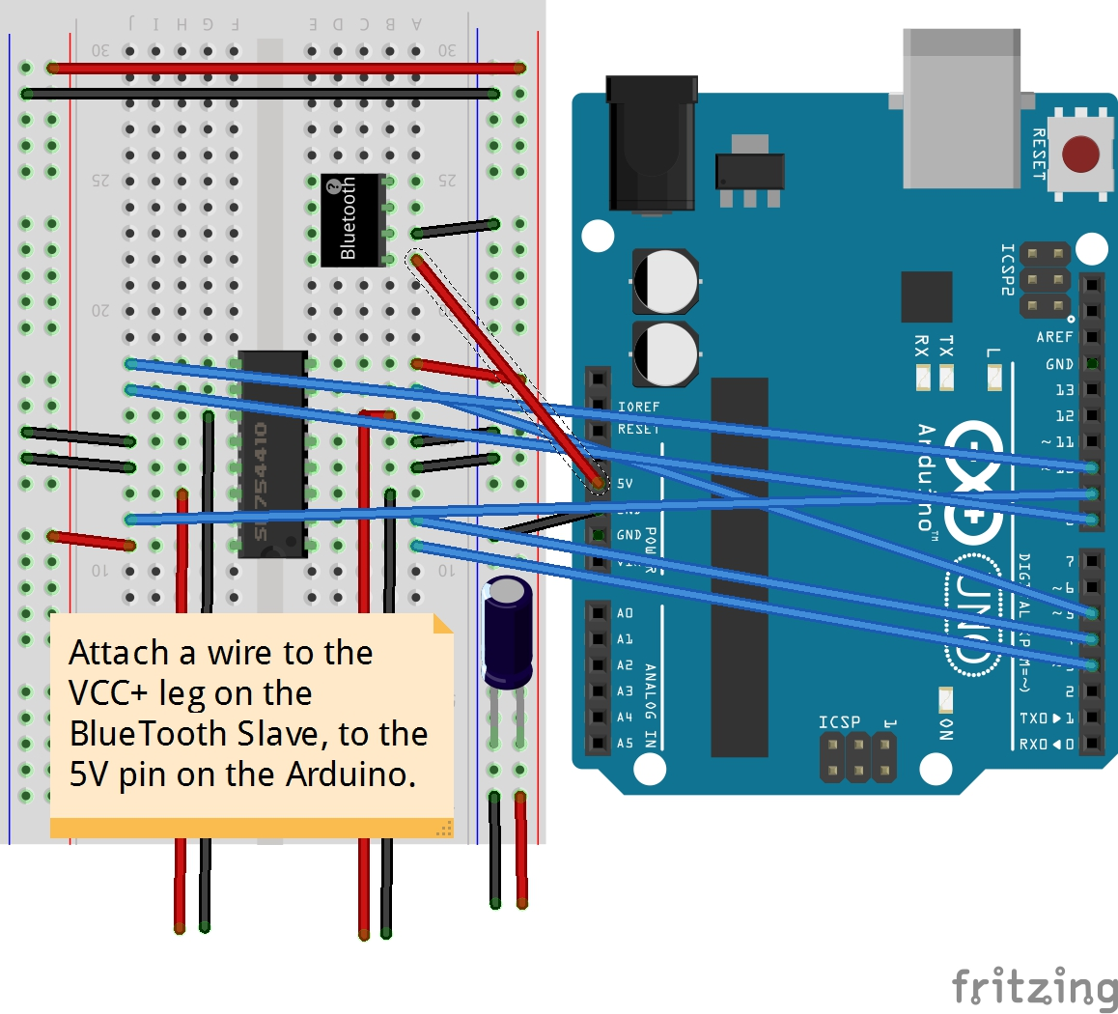
Step Sixteen

Slide 20
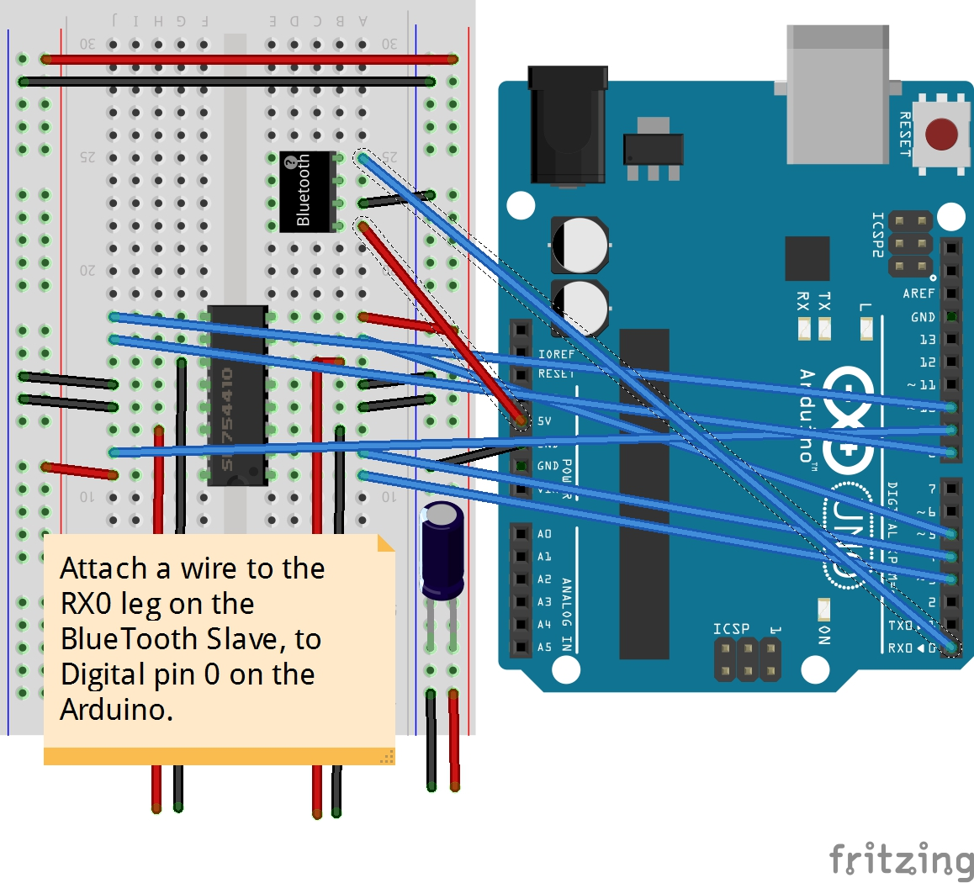
Step Seventeen

Slide 21

Step Eighteen

Slide 22
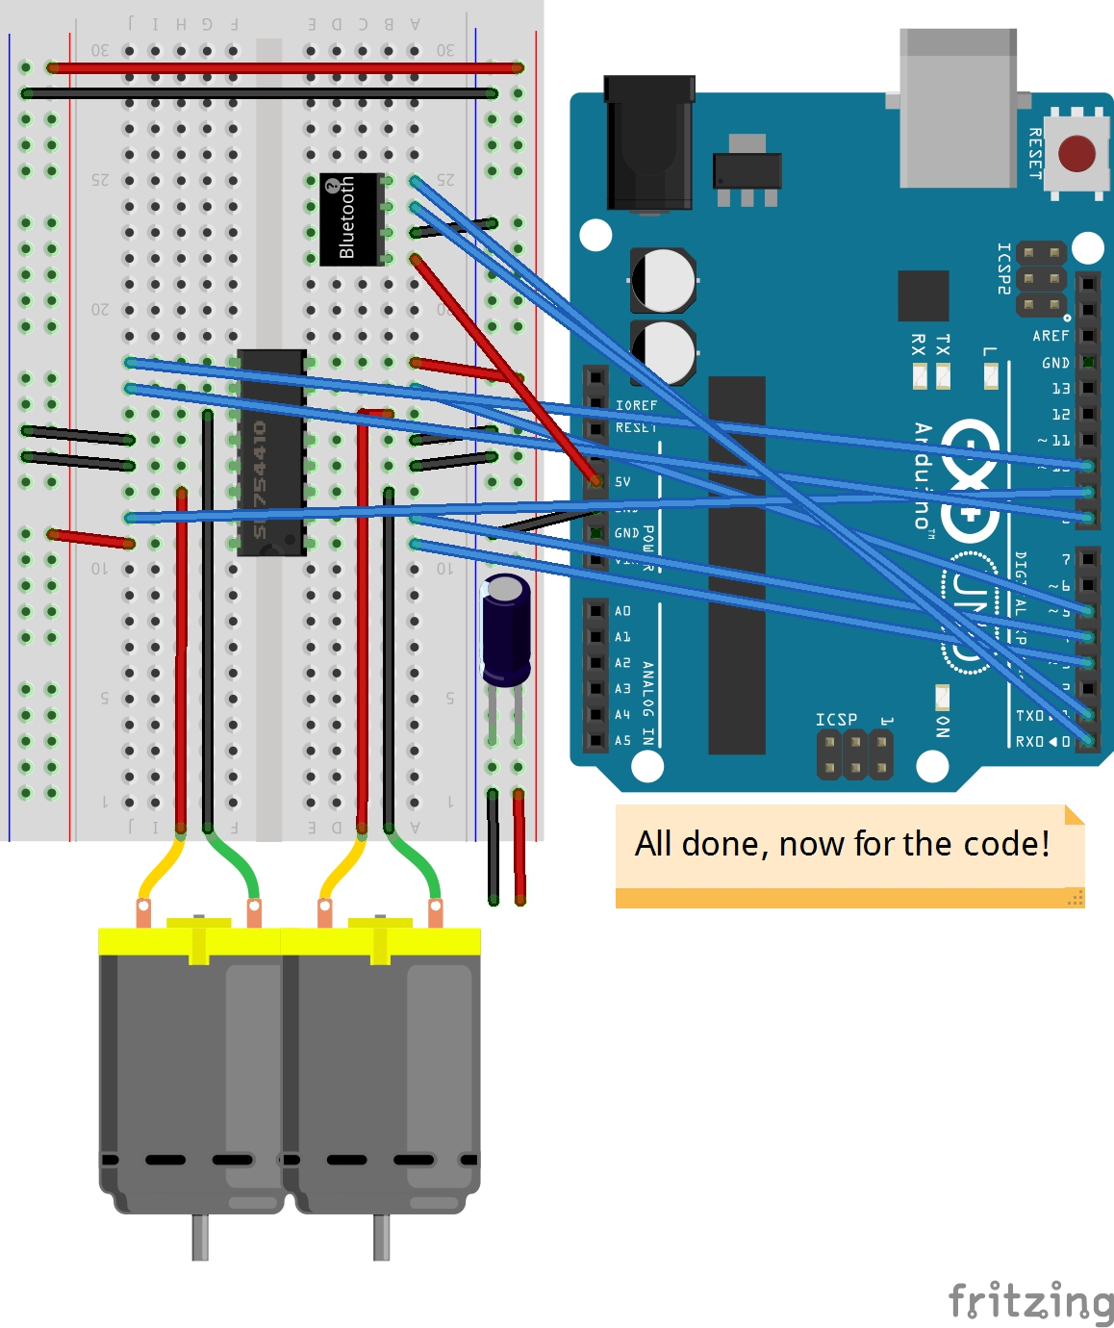
Step Nineteen

Slide 23
Programing The Arduino

